Slide 1
Automated toll collection and theft detection using Rfid and image processing
CPG No. 63
Shivam Bhushan – 101783039
Sehajbir Singh – 101603309
Shervil Gupta – 101603312
Shivam Mittal – 101603316
Mentor – Dr. Deepshikha Tiwari

Slide 2
Table of contents
S. No. | Topic | Slide No.
1 | Need Analysis | 3
2 | Objectives | 4
3 | Engineering tools/principles used | 5-6
4 | Constraints and assumptions | 7
5 | Detailed Design of the project | 9-12
6 | Components Used | 13
7 | Proposed Algorithm | 14
8 | Work Accomplished | 15

Slide 3
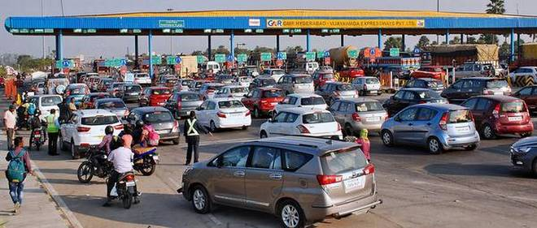
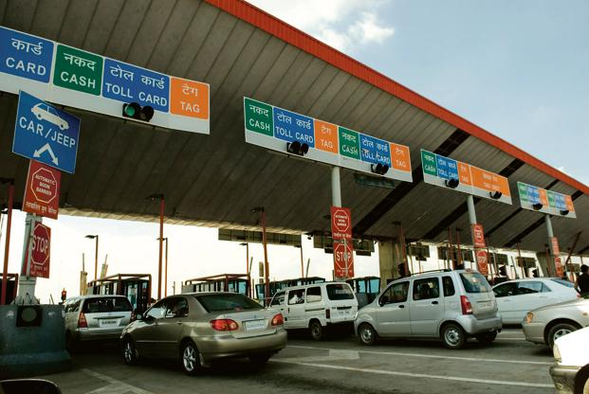
Need analysis
Long Lines at Toll Plazas.
Minimal reduction in waiting time even
after implementation of modern systems like Fastag.

Slide 4
oBJECTIVES
Faster transit on Toll Roads.
Cashless Toll Deductions.
Effective Theft and Tampering Detection.
To save time and fuel.

Slide 5
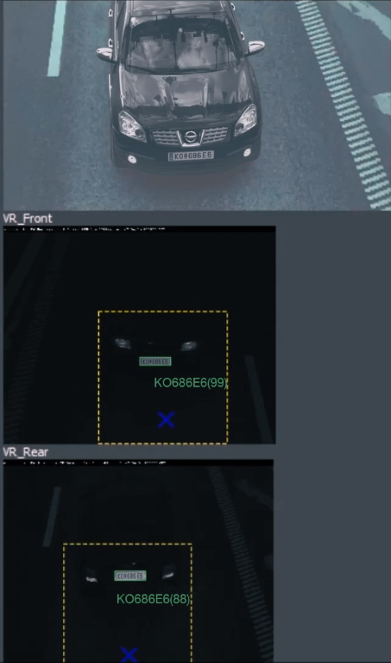
Engineering tools/principles used
1. Detection of Front and Rear Vehicle Identification Plate Using OCR(Optical Character Recognition).

Slide 6
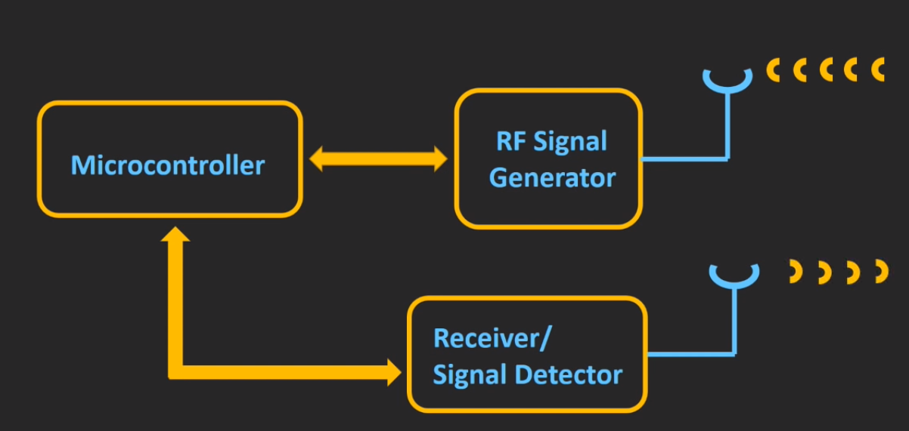
2. Radio Frequency
Identification System.

Slide 7
Constraints and assumptions
No vehicle Identification plate is damaged beyond recognition.
It’s made mandatory by RTO to get the RFID system installed.
The vehicle should not be going at an exceptionally high speed.

Slide 8

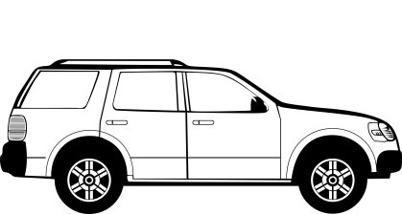
Detailed DESIGN of the project
Internet
Connection
RFID Scanner
Cameras to Scan ID plates
Processing Unit located at the
Toll plaza
Central Database
Containing Details of
All vehicles

Slide 9
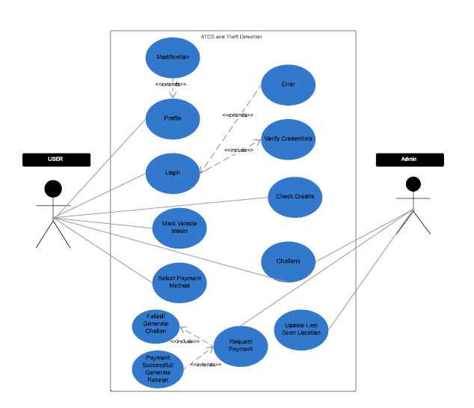
USE CASE

Slide 10
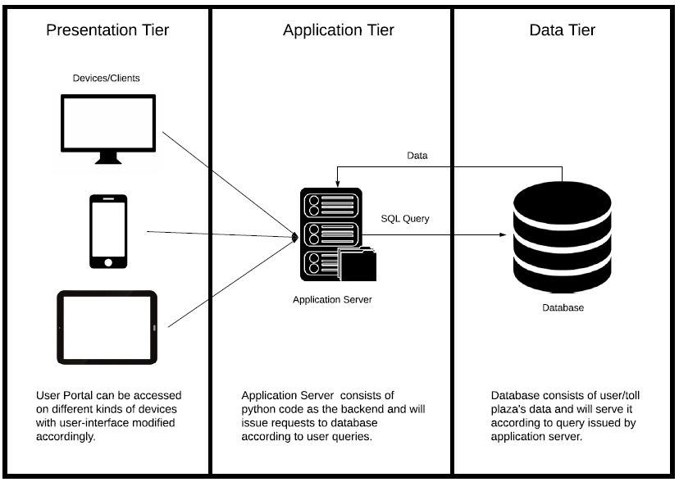
3 TIER ARCHITECTURE

Slide 11
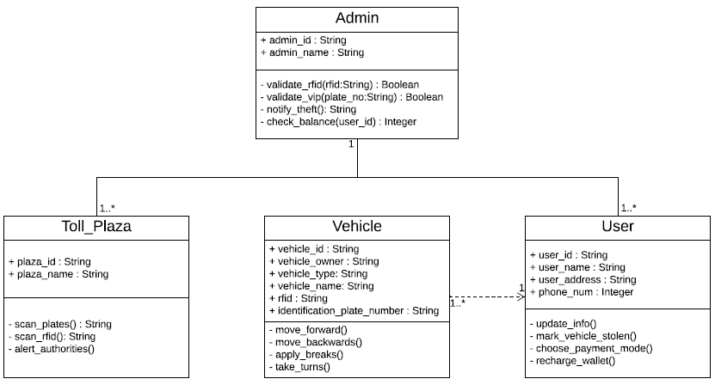
CLASS DIAGRAM

Slide 12
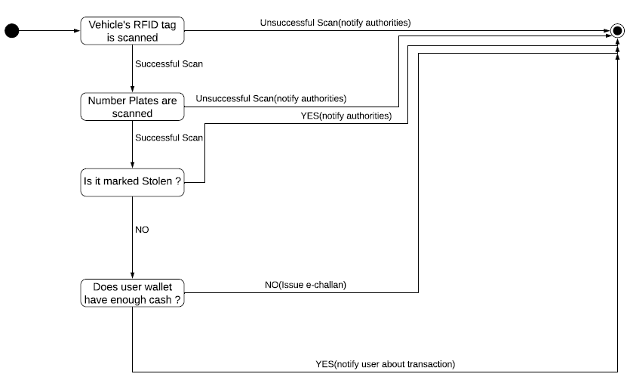
STATE CHART

Slide 13
Components used
Radio Frequency Identification (RFID) Technique.
Optical Character Recognition (OCR) Technique.
Image Processing Technique
Slow Motion High Definition Cameras.
Raspberry Pi (or similar single board computer).
Web and Mobile Portal.

Slide 14

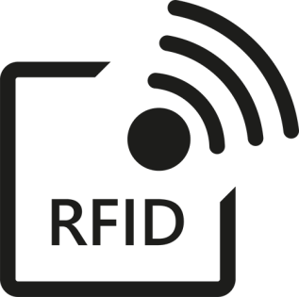

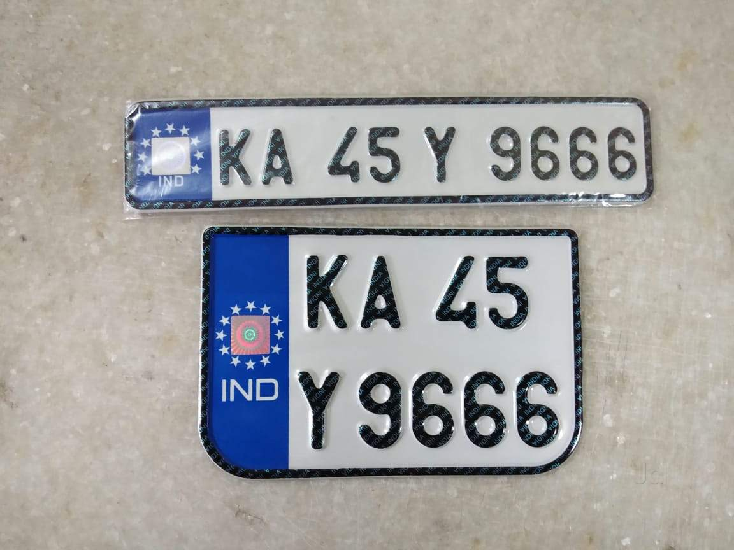
Proposed toll deduction Algorithm
Processing Unit at
Toll Plaza
Prepaid Account
Linked to RFID
Prepaid Account Linked to Vehicle Identification Plate
E-Challan Sent to
User’s Portal

Slide 15
WORK ACCOMPLISHED
Till now the model is finished with one module which contain the code and output for
an image of vehicle license plate. Code for number extraction is implemented in
python. Still, working on the RFID module to increase its efficiency for smooth
scanning.

